Slide 1









Urban Renewal: Investing in People

Slide 2
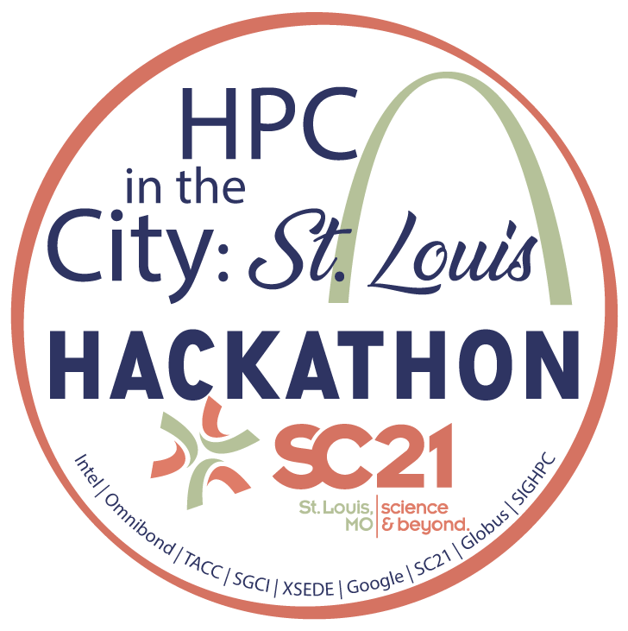
Urban Renewal: Investing in People
Geoffrey Reid (TACC)
greid@tacc.utexas.edu
Idea: Urban neighborhood revival 1st Steps
Creating 1st wholistic opportunities for
infrastructure and support to plan urban renewal.

